Slide 1

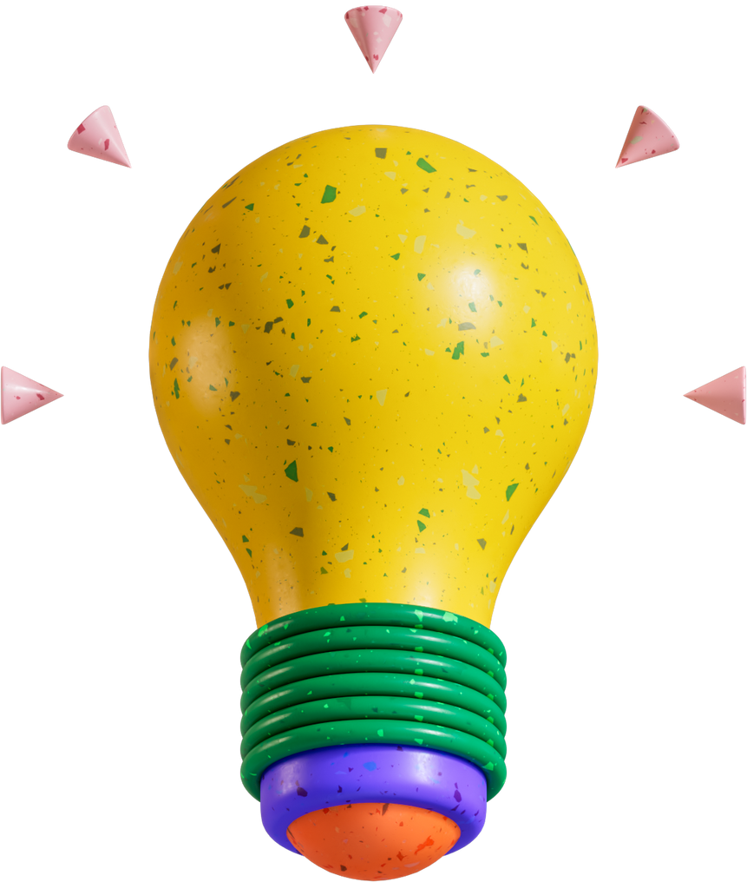
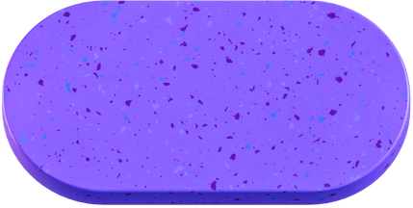


APPEARED IN MY MIND
Musa ( Moses ) Sina ( Cena ) ERTUGRUL ( IDK How to translate )

Slide 2
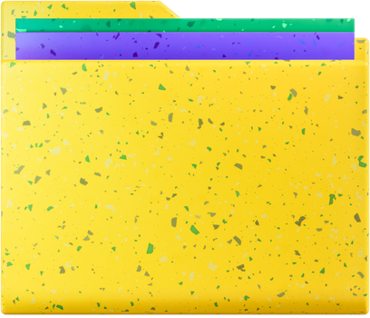
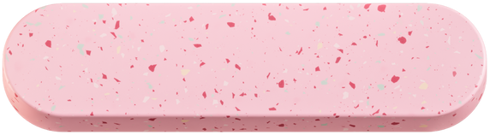
Overview
Chart of our Journey
OBJECTIVES
GOALS
Overview on Problems
Covering Some Design Problems
Current Point
RFC 0014
Overview on Solutions
Iteration 1
Iteration 2
Iteration 3
Covering Problems better
Covering Suggestions
Back to Agenda Page

Slide 3
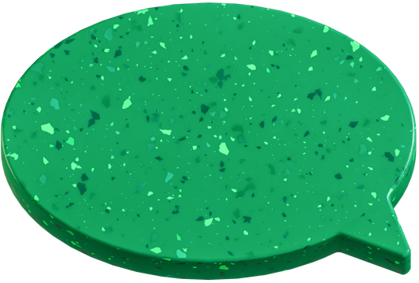
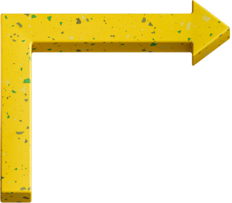
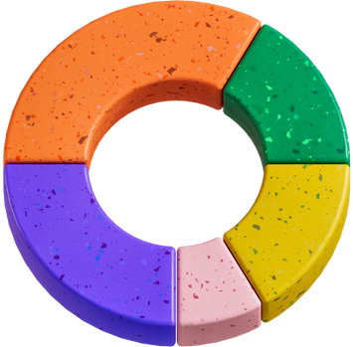
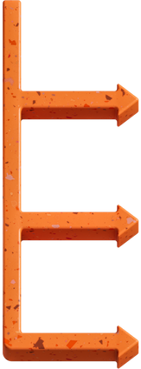
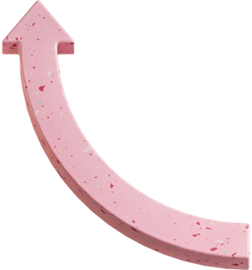
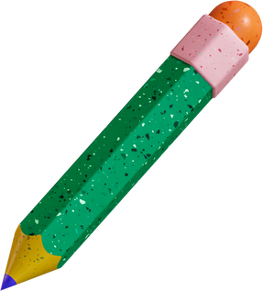
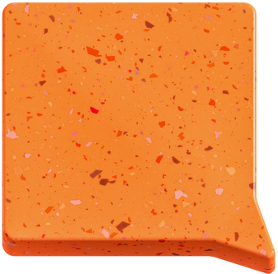
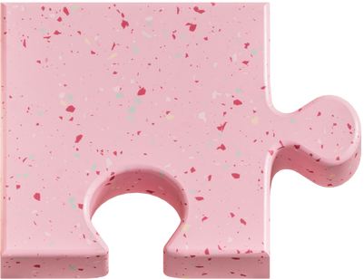

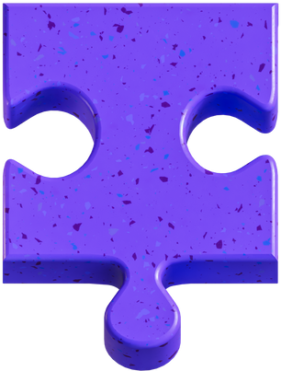
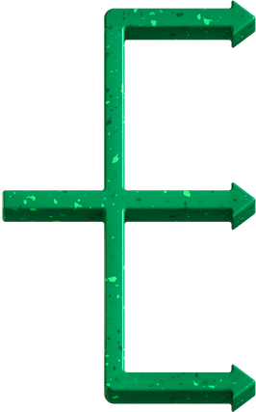
Covering Some Design Problems

Slide 4
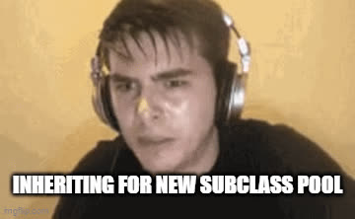
COMPOSITE
Actually, It is not problem but,
when you have n! variation
Things become messy
We need “Flexibility and Less Classes”
Back to Agenda Page

Slide 5
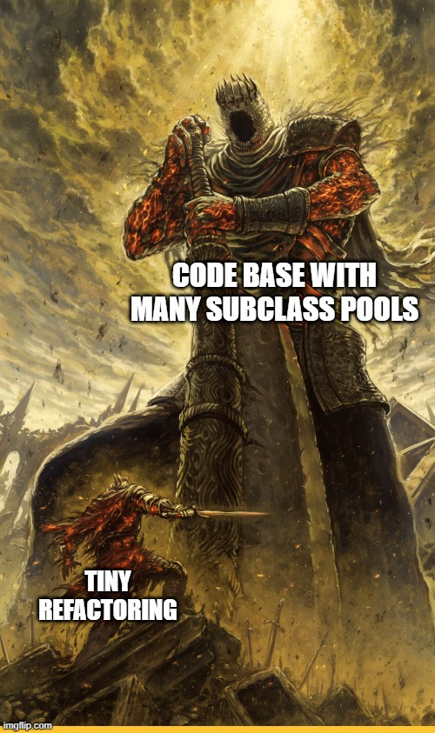
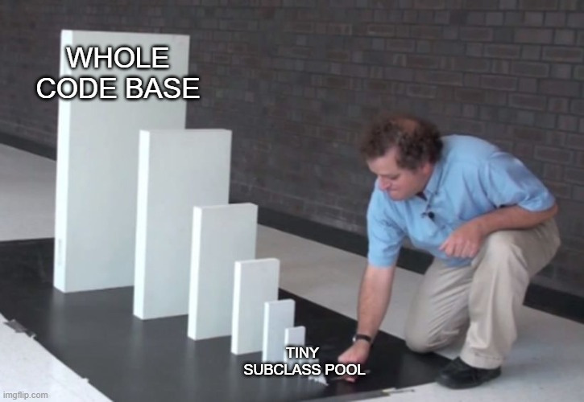
Back to Agenda Page

Slide 6
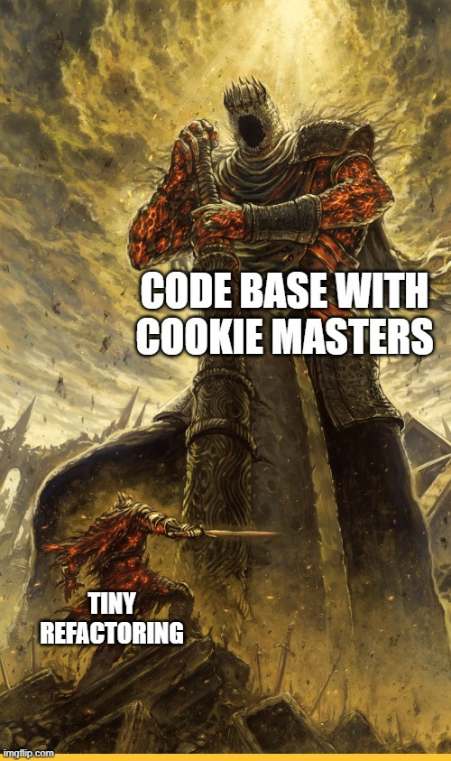
COOKIE MASTER CLASS OR OBJECT
This problem violates SOLID principles
Objects and Classes must do less job as possible
Back to Agenda Page

Slide 7
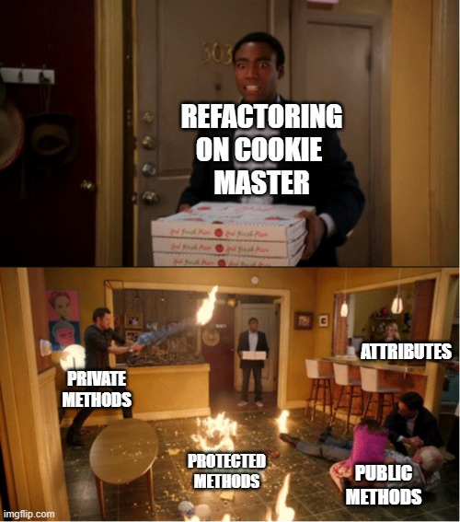
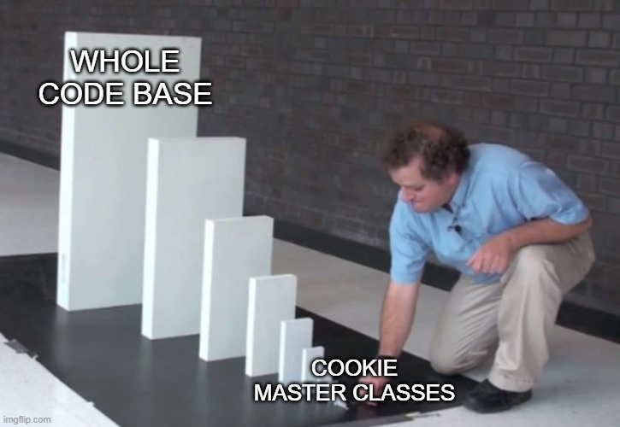
Back to Agenda Page

Slide 8
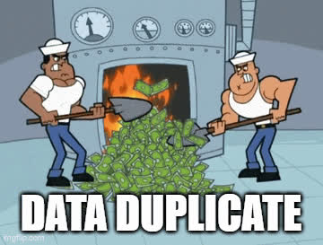
DATA DUPLICATE
Allocates more memory
Confusing needed data
Back to Agenda Page

Slide 9
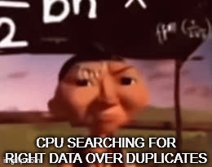
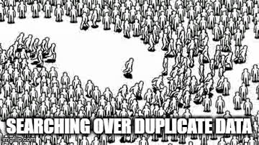
Back to Agenda Page

Slide 10
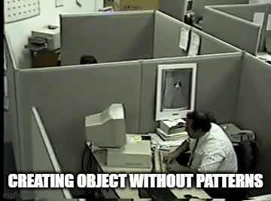
BAD HANDLED BUILDING
Repeated code chunks
Losing time for reading implementation
Back to Agenda Page

Slide 11
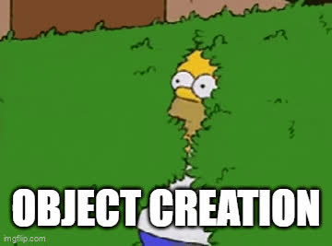
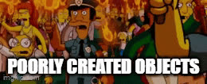
Back to Agenda Page

Slide 12
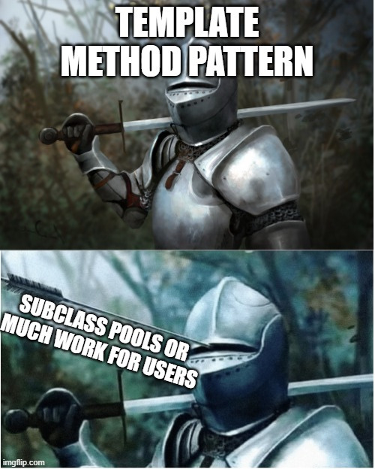
TEMPLATE METHOD PATTERN
Actually, It is not problem but,
When you have a variety of class pools
This pattern grow exponantially
also, users will need to implement exponential growth
Back to Agenda Page

Slide 13
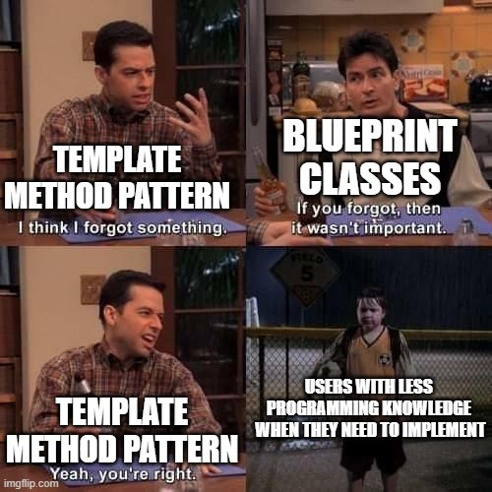
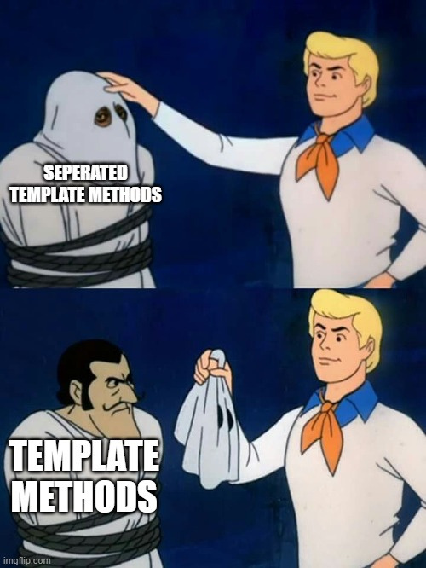
Back to Agenda Page

Slide 14
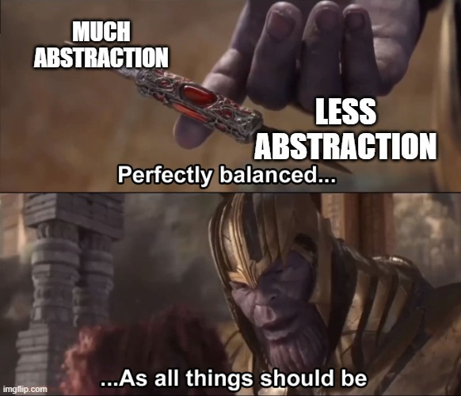
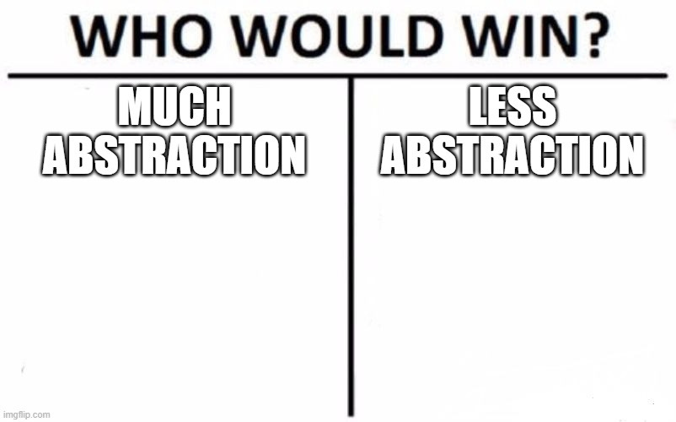
Back to Agenda Page

Slide 15
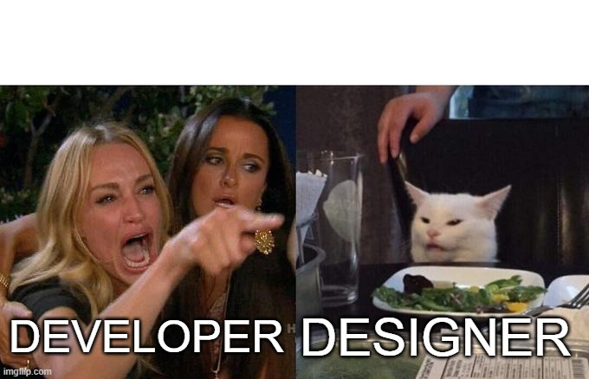
COUPLING
If, the system has high coupling, that will affect future upgrades in a worse way
Back to Agenda Page

Slide 16
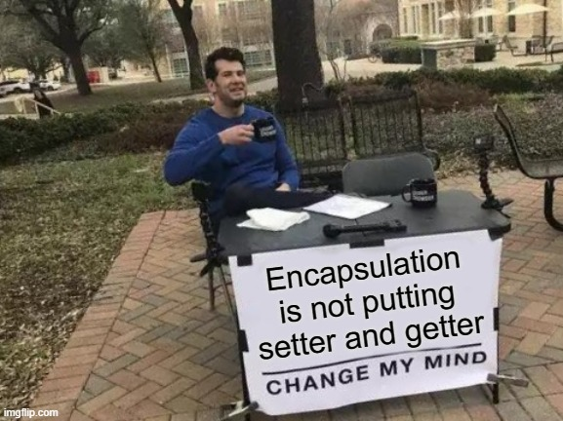
ENCAPSULATION
This concept is a misunderstood concept. It is not putting setter, getter
Back to Agenda Page

Slide 17

5 minute break

Slide 18
Current Point

Slide 19
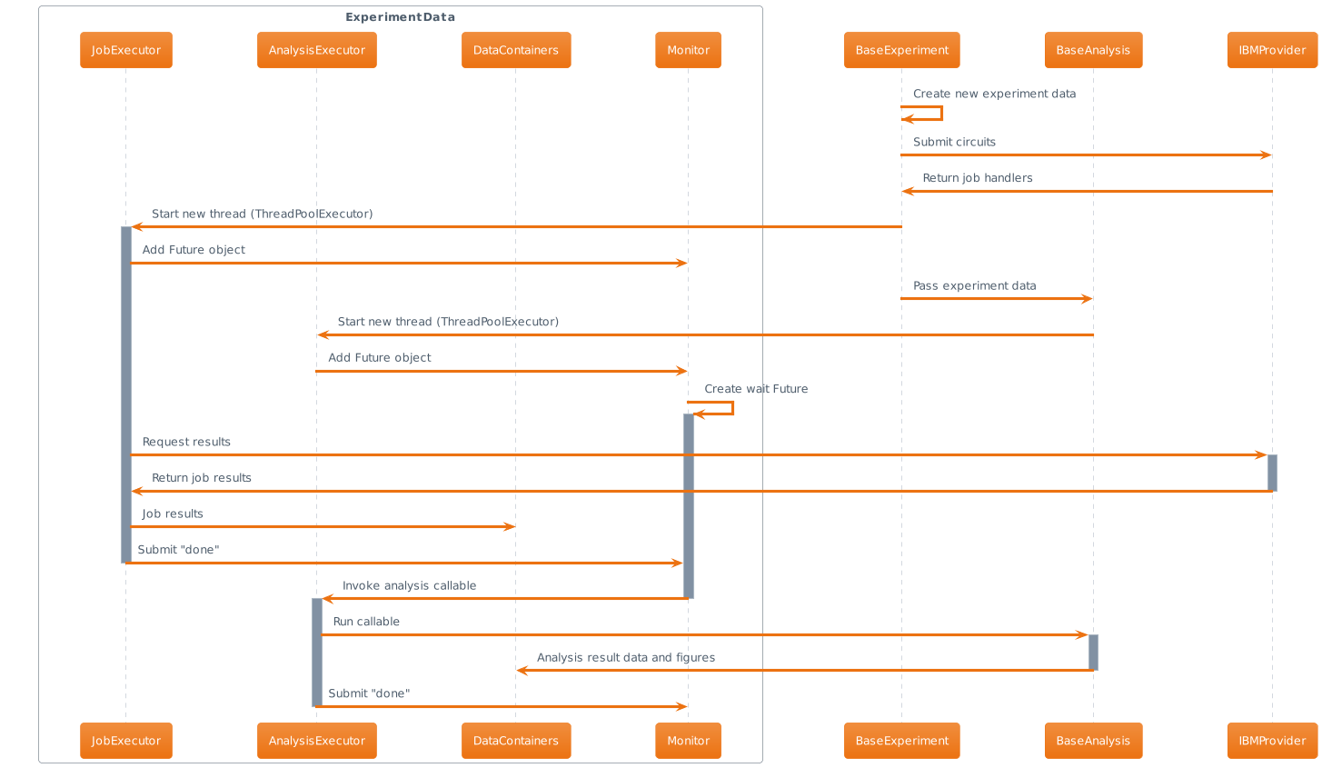
Too many jobs
Unhandled Building
Creating too many structures for one time use
Complicated flow

Slide 20
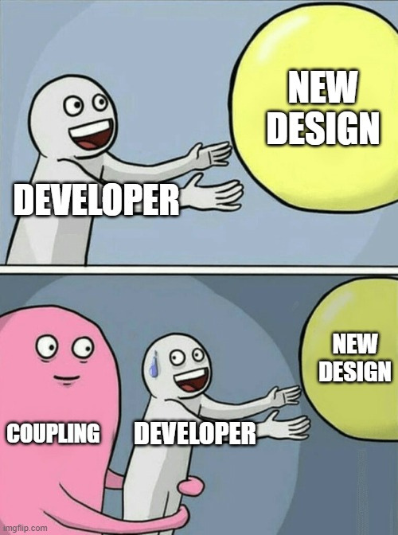
ALSO,
The current Comp Analysis system bootstraps other classes and objects with its own methods etc. This situation raises coupling and the current system has no interfaces. Therefore, this situation affected coupling in an unwanted way ( This is against DIP )
Back to Agenda Page

Slide 21
RFC 0014

Slide 22
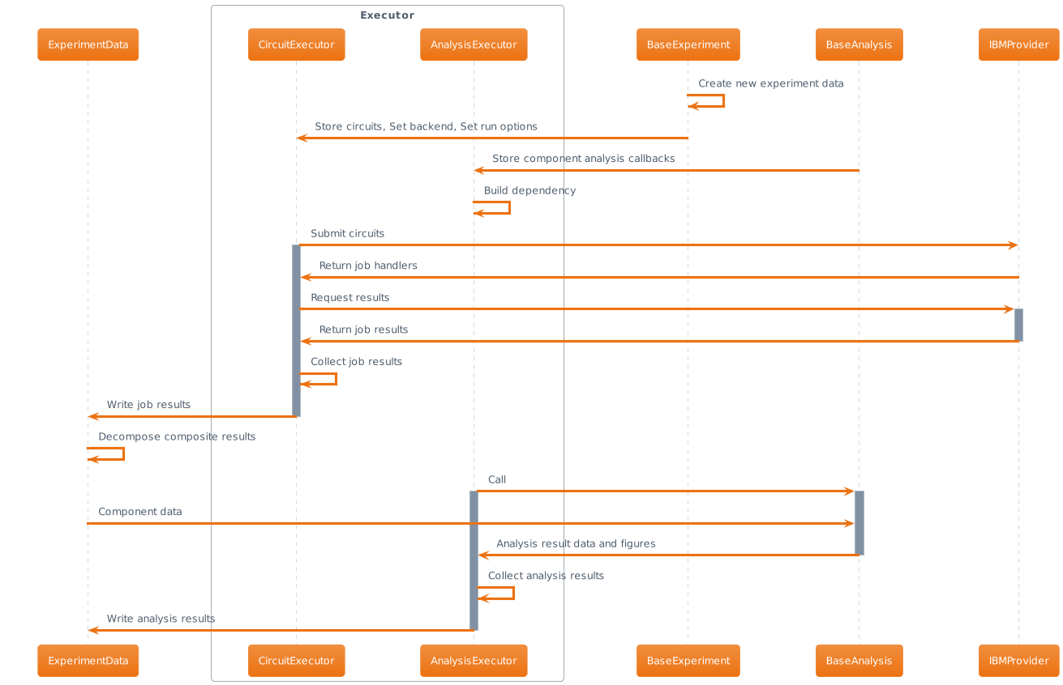

Slide 23
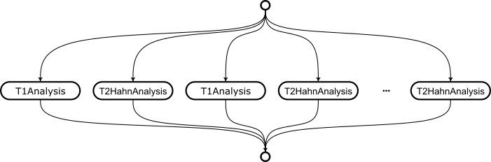

Slide 24
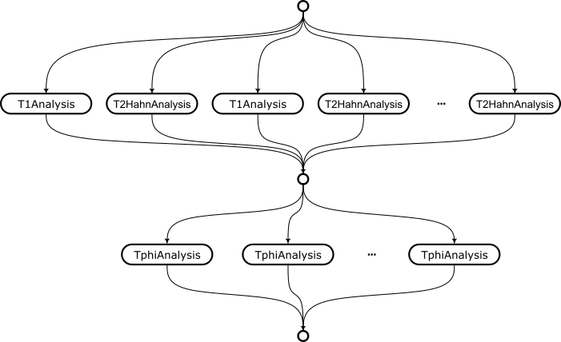

Slide 25
PROS
CONS
Less responsibility
Less jobs
Template Methods
Separated Data Container
Unhandled Object Creation / Seperated Object Creation
More Maintainable
Easy flow
Maybe, Low Abstraction ( Low abstraction can be problem for future updates )
Solved Composite workflow
Reduces Coupling
. . .
Back to Agenda Page

Slide 26
LET’S INHERITE PROS FROM RFC 0014
AND LET’S SOLVE CONS
Back to Agenda Page

Slide 27
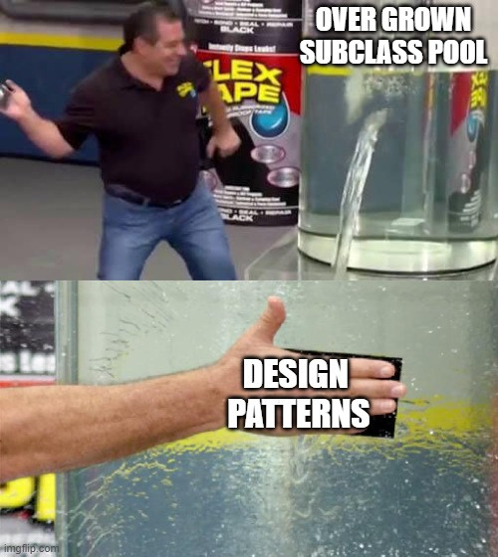
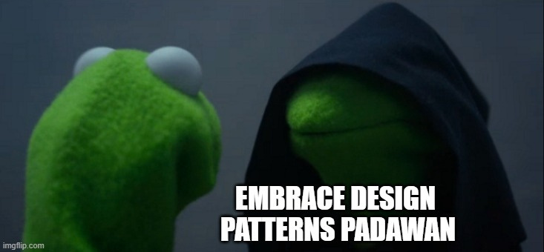
NAOKI
ME
Back to Agenda Page

Slide 28
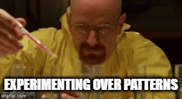
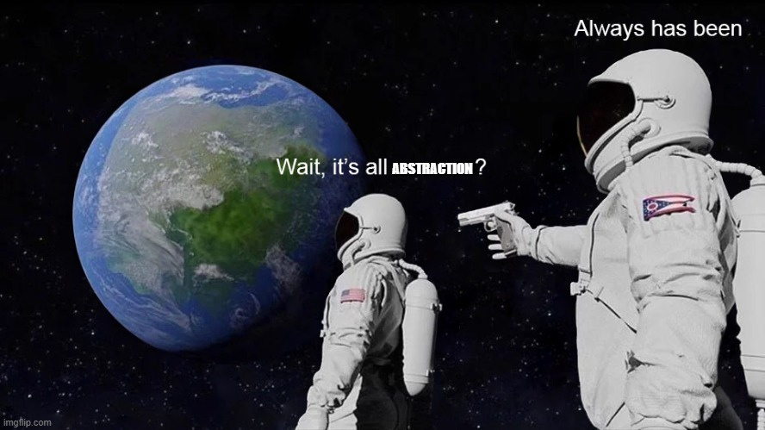
Back to Agenda Page

Slide 29
Iteration 1

Slide 30
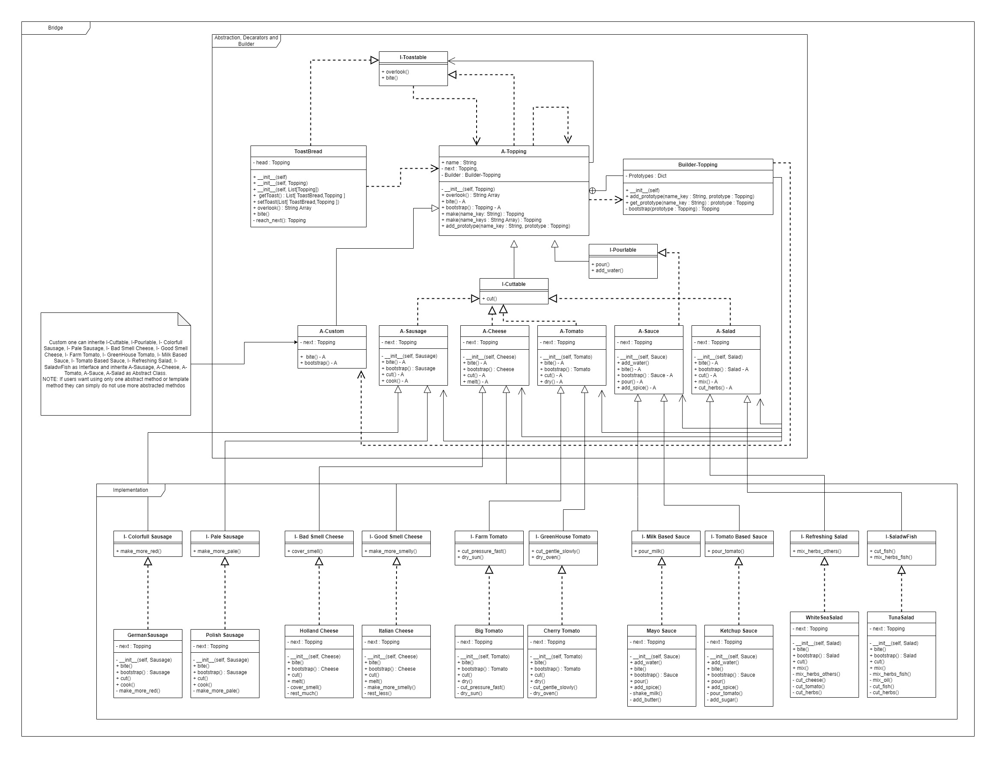

Slide 32
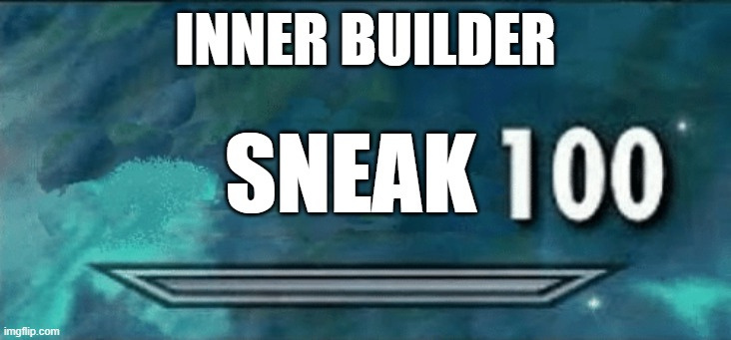
INNER BUILDER
This Builder also, accepts custom objects and store them in dict that also contain pre-generated objects
Back to Agenda Page

Slide 33
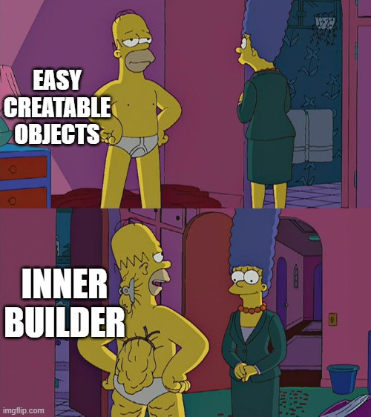
Back to Agenda Page

Slide 34
5 minute break

Slide 35
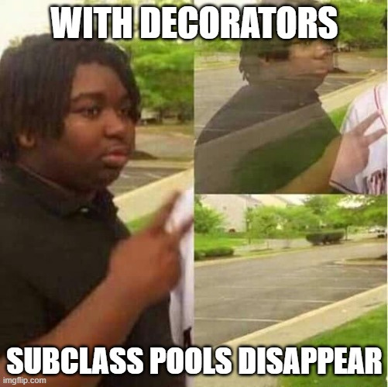
DECORATORS
With pluggable and unpluggable objects we get rid of n! composite pattern subclass pool
also, users can create systems with pre-defined and custom-defined objects so, effects of template method pattern will be less
Back to Agenda Page

Slide 36
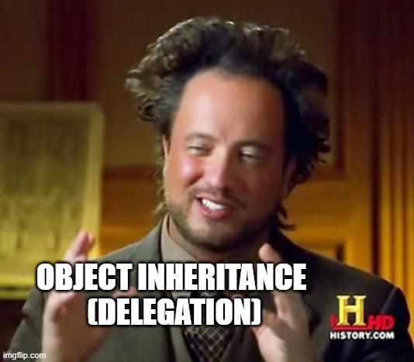
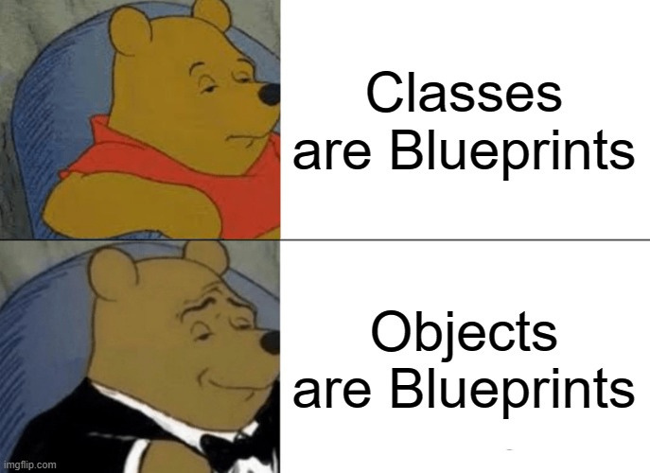
Back to Agenda Page

Slide 37
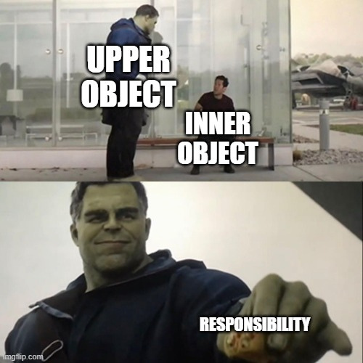
You are doing GREAT,
Please stick me a little bit more
Back to Agenda Page

Slide 38
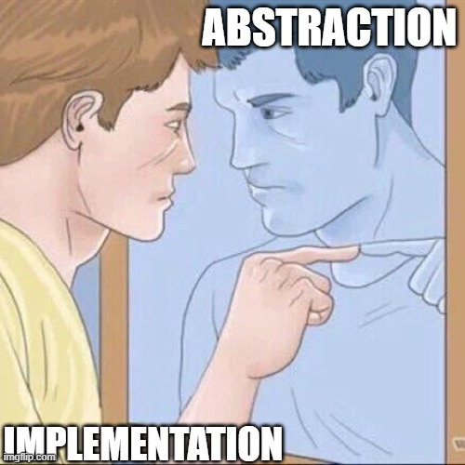
BRIDGE
If we use the bridge pattern, the base of experiments will be the same ( abstraction ) and other parts can variate from implementations
Back to Agenda Page

Slide 39


Back to Agenda Page

Slide 40
Iteration 2

Slide 41

RUNTIME INHERITANCE
With Runtime Inheritance, Decorators can be more useful and
also, this can be used for classes to make them objects like structures that can change during runtime
Back to Agenda Page

Slide 42

COMMAND AND TEMPLATE METHOD
If we use both of them together, users will have custom types and predefined types.
Also, they can plug and unplug commands.
If they want they can create their custom commands with template methods
Back to Agenda Page

Slide 43


Back to Agenda Page

Slide 44
Iteration 3

Slide 45

PROXY
Experiment Data Container can be a proxy over the result database. ( This can be useful over huge projects and while using copies of experiment data ). We can add store: bool flag.
Back to Agenda Page

Slide 46


Back to Agenda Page

Slide 47

MORE INTERFACES
Adding interfaces will be a contract among connected hierarchies so, this will reduce the coupling of the current system and this leads us though DIP
Back to Agenda Page

Slide 48


Back to Agenda Page

